Slide 1




ABC Automobile
The Managers have no tools to evaluate the company’s performance
The company managers decided to reach out to Prerana’s company for a Data Driven Solution
Data Driven Solution

Slide 2

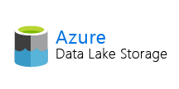








SOURCE
INGEST
STORE
PROCESS
MODEL
SERVE
Linked Service
Synapse Spark
Synapse Serverless SQL
Linked Service
Azure SQL DB
Copy Activity
Raw – Parquet Format
Curated Notebook
Curated (Delta Format)
OPENROWSET VIEWS
MASTER PIPELINE
DATA STORAGE ZONE
DATA ENRICHMENT ZONE
DELIVERY ZONE

Slide 3
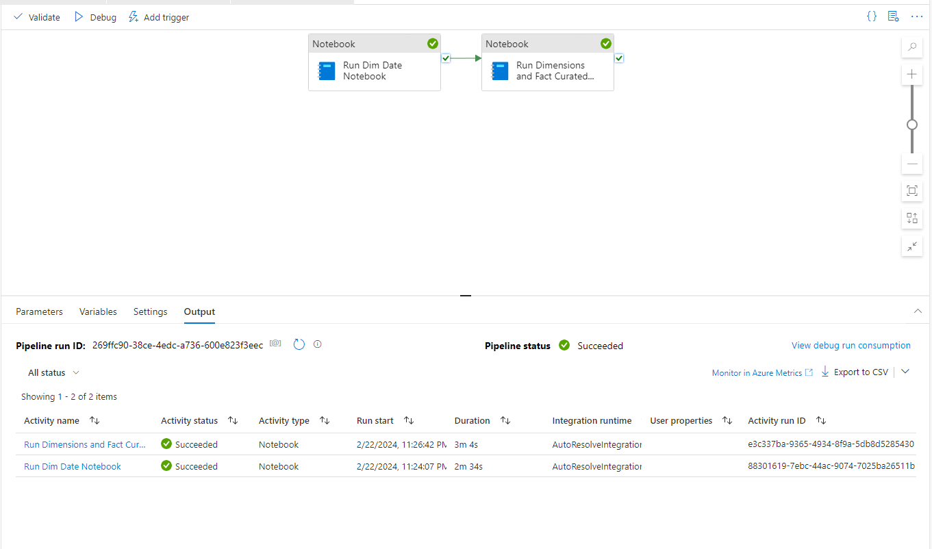

Slide 4
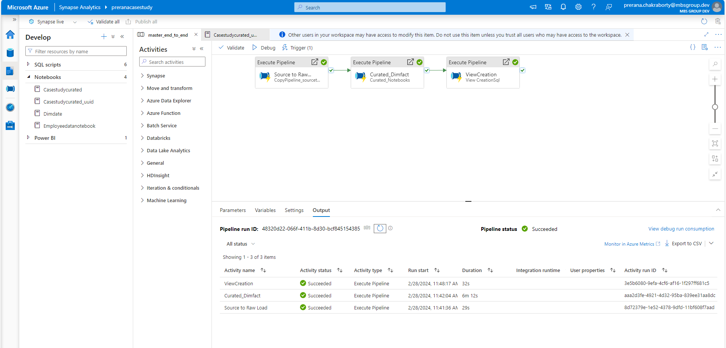
MASTER PIPELINE (END – TO – END )

Slide 5
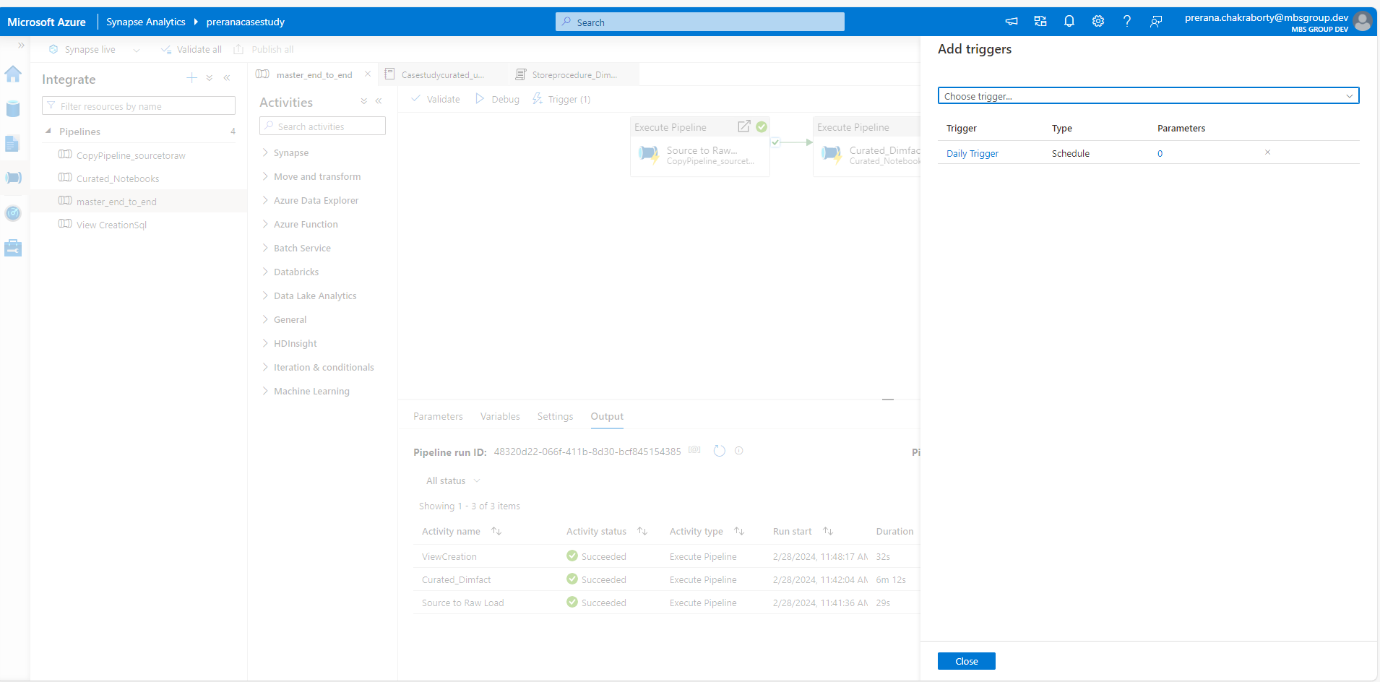
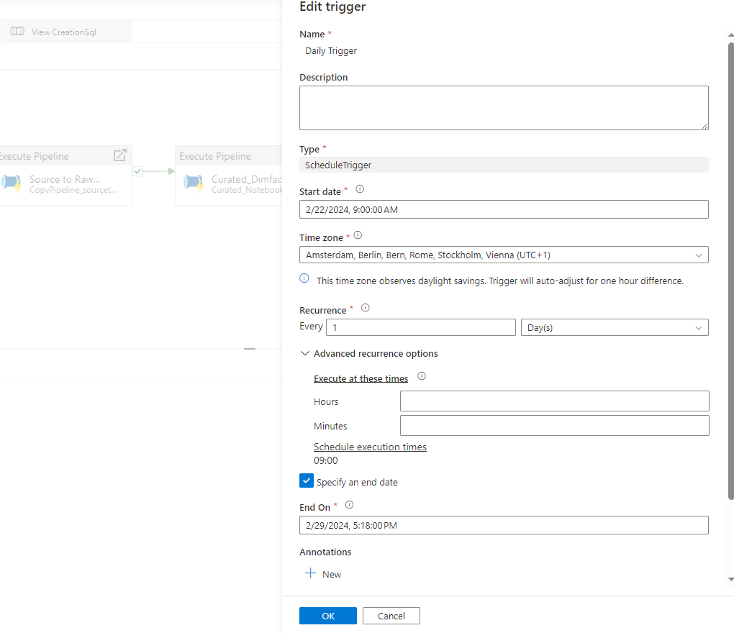
DAILY TRIGGER

